Slide 1
FACE MASK DETECTION SYSTEM
TEAM MEMBERS :
Padakandla Venkata Naga Sai Hasini (21UP1A6638) Pendkar Srivani (21UP1A6637) Pendurthi Jyothsna (21UP1A6636)
GUIDE : Dr. M. Thejovathi
DESIGNATION : Assistant Professor
DEPARTMENT : AI&ML

Slide 2
CONTENTS
Abstract
Introduction
Problem Statement
Literature Survey
Existing Systems
Existing Systems Drawbacks
Proposed Systems
Algorithms Used
Technologies Used
Implementation
Results
Conclusion
Future Scope
References

Slide 3
ABSTRACT
The Face Mask Detection System is a computer vision-based solution that identifies whether individuals are wearing face masks in images. Using pre-trained deep learning model, such as convolutional neural networks (CNNs), the system processes static images to classify faces as masked or unmasked with high accuracy. It is designed for non-real-time scenarios, analyzing pre-captured images rather than live video feeds. The system's primary applications include ensuring compliance with public health guidelines in static environments like entry points and workplaces. Efficient preprocessing and training on diverse datasets enable robust performance across various lighting conditions and face orientations. This system contributes to automating safety measures and reducing manual monitoring efforts.

Slide 4
INTRODUCTION
The importance of face masks has been globally recognized for preventing the spread of airborne diseases, especially during the COVID-19 pandemic. Mask-wearing regulations were introduced worldwide to protect public health, but ensuring compliance in crowded areas remains challenging. Manual monitoring methods are time-consuming, labor-intensive, and error-prone, highlighting the need for automated solutions. This research aims to develop a Face Mask Detection System using machine learning and computer vision techniques. The system processes images to determine mask compliance, offering a scalable alternative to manual monitoring. By integrating into existing surveillance systems, it can enhance safety in various environments such as hospitals, schools, and public transport. This automated approach supports adherence to health protocols, reduces disease transmission, and ensures safer public spaces.

Slide 5
PROBLEM STATEMENT
With the global rise in airborne diseases, such as COVID-19, ensuring public safety has become a priority. Wearing face masks is a proven method to reduce the transmission of such diseases. However, monitoring and enforcing mask compliance in public spaces, workplaces, or schools can be challenging.

Slide 6
LITERATURE SURVEY
S.NO | TITLE | DETAILS | METHODOLOGIES AND ACHIEVEMENTS | LIMITATIONS
1. | SCS-Net: An Efficient and Practical Approach Towards Face Mask Detection | Umar Masud et al. Link: https://www.sciencedirect.com/science/article/pii/S1877050923001655 | SCS-Net achieves 95.54% accuracy on a three-class face mask dataset with just 0.12M parameters. | Occlusions, complex lighting, and limited real-time video evaluation, hindering deployment in dynamic environments.
2. | Face Mask Detection in COVID-19: A Strategic Review | Vibhuti et al. Link: https://link.springer.com/article/10.1007/s11042-022-12999-6 | The study explores CNN, YOLO, SSD, and Faster R-CNN for face mask detection using real-time datasets and deep learning. | Poor lighting, occlusions, motion blur, and balancing accuracy with computational efficiency on large datasets.

Slide 7
LITERATURE SURVEY
S.NO | TITLE | DETAILS | METHODOLOGY AND ACHIEVEMENTS | LIMITIONS
3. | Face mask detection using deep learning | Shilpa Sethi et al. Link: https://www.sciencedirect.com/science/article/pii/S1532046421001775 | Developed a CNN-based face mask detection model with high accuracy and real-time performance, enhancing public safety during the pandemic. | Struggles with detection in poor lighting, occlusions, and non-standard mask usage
4. | Face Mask Detection using Machine Learning | Prof. Ajay Talale et al. Link: https://www.ijnrd.org/viewpaperforall?paper=IJNRD2307032 | The system uses MobileNetV2 with Keras, TensorFlow, and OpenCV for face mask detection, achieving 98% accuracy. | Limited dataset size, poor detection under lighting or occlusions, and reliance on pre-defined datasets, affecting real-world adaptability.

Slide 8
EXISTING SYSTEMS
OpenCV-based Systems: Utilize pre-trained Haar cascades or DNN models for detecting face masks in images and videos.
YOLO-based Systems: Use YOLO (You Only Look Once) for high-speed and accurate mask detection.
Government and Enterprise Tools: Custom-built systems for large-scale monitoring in cities, workplaces, and schools.
Multi-class Systems: Detect not only the presence of masks but also their proper positioning

Slide 9
EXISTING SYSTEMS DRAWBACKS
Low Accuracy in Low Light: Struggle to detect masks accurately in poor lighting conditions.
High False Positives: Misidentifies individuals not wearing masks or vice versa.
Limited Scalability: Performance decreases with a larger number of individuals in crowded areas.
Dependency on Clear Visibility: Fails with partially covered faces, angles, or obstructions.
High Computational Cost: Requires significant hardware resources for real-time detection.

Slide 10
PROPOSED SYSTEM
Image-Based Input: The system processes pre-captured images to identify individuals wearing or not wearing face masks.
Deep Learning Model: Utilizes a trained convolutional neural network (CNN) for accurate face and mask detection.
Preprocessing Module: Includes image resizing, normalization, and augmentation for consistent input to the model.
Mask Classification: Classifies faces into categories (e.g., masked and unmasked) based on trained data.

Slide 11
ALGORITHMS AND TECHNOLOGIES USED
Image Preprocessing: Resize, normalize, and enhance input images for consistent model training and testing.
Convolution neural networks : Apply CNNs to extract key features of the face for distinguishing masked and unmasked faces.
Python: For developing and implementing the model.
TensorFlow/Keras: Frameworks for building and training the deep learning model.
OpenCV: Used for image preprocessing and transformations.

Slide 12
IMPLEMENTATION
Data Processing: Images are resized to 128x128 pixels, labeled for "with mask" or "without mask," and split into training and testing sets. Pixel values are normalized to a range of 0 to 1.
Model Building: A CNN model with convolutional, max-pooling, and fully connected layers is built to classify images. The output layer predicts probabilities for "with mask" and "without mask.“
Model Training: The model is trained using the Adam optimizer and sparse categorical cross-entropy loss. Iterative training updates parameters to improve classification accuracy over epochs.
Evaluating the Model: The model's performance is evaluated using test accuracy and plotted curves for training and validation loss. These curves help identify overfitting or underfitting.
Prediction on Images: The trained model processes new images to predict mask status. It analyzes input and outputs the class ("with mask" or "without mask") with the highest probability.

Slide 13
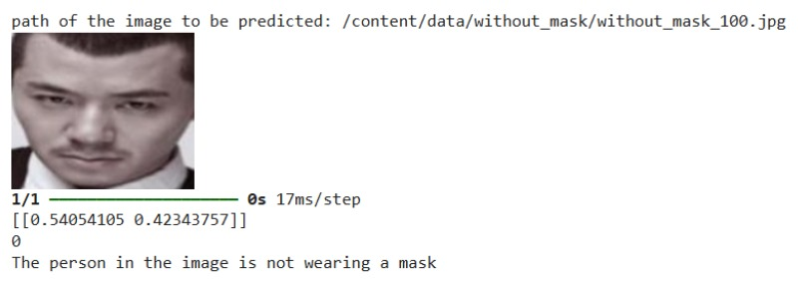
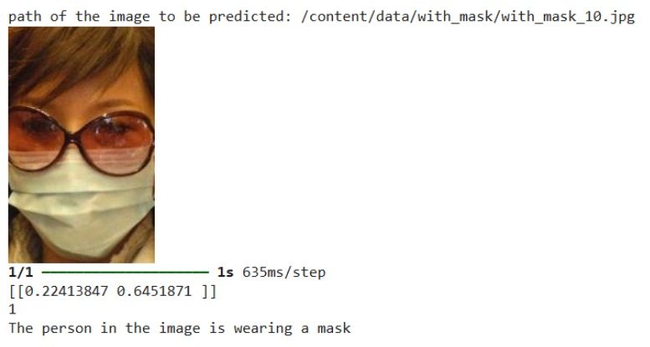
RESULTS

Slide 14
CONCLUSION
The Face Mask Detection System demonstrates the application of deep learning to address public health challenges by automating mask compliance monitoring. Utilizing Convolutional Neural Networks, the system achieves high accuracy in detecting mask usage from images, making it suitable for diverse environments such as public spaces, workplaces, and healthcare facilities. The lightweight and scalable design reduces the need for manual monitoring and enhancing public safety protocols. This project highlights the potential of artificial intelligence in solving modern health and safety issues and provides a foundation for future advancements, including broader health monitoring applications and improved detection accuracy.

Slide 15
FUTURE SCOPE
The future scope includes integrating the system with real-time surveillance for continuous monitoring and improving accuracy. It can detect improperly worn masks, classify different face coverings, and be optimized for edge devices like IoT and mobile phones. The system can also support multi-factor analysis by combining mask detection with social distancing and temperature checks. It holds potential for large-scale deployment in industries like healthcare, education, and transportation. Research on data augmentation and semi-supervised learning can further enhance its performance for global health applicaations.

Slide 16
REFERENCES
[1]M. Almghraby, A. Elnady, Face Mask Detection in Real-Time using MobileNetv2 International Journal Of Engineering And Advanced Technology (2021)
[2] Abdallah, Z.S., Du, L. & Webb, G.I. 2017, 'Data preparation', in C. Sammut & G.I. Webb (eds), Encyclopedia of machine learning and data mining, Springer.
[3] World Health Organization et al. Coronavirus disease 2019 (covid-19): situation report, 96. 2020. - Google Search. (n.d.).
[4]S. Feng, C. Shen, N. Xia, W. Song, M. Fan, B.J. Cowling Rational use of face masks in the COVID-19 pandemic

Slide 17


